Slide 1
A Report to Investigate Three Technical Solutions to Prevent Dirty Masjid Toilet in Ankara Gençlik Parkı
Kutay Şenyiğit
21902377
ENG 401-12

Slide 2
Contents
Introduction
Problem Definition
Proposed Solutions
Criteria for Assessing Proposed Solutions
Proposed Research Methodology
Results and Analysis
Conclusion and Recommendations
References

Slide 3
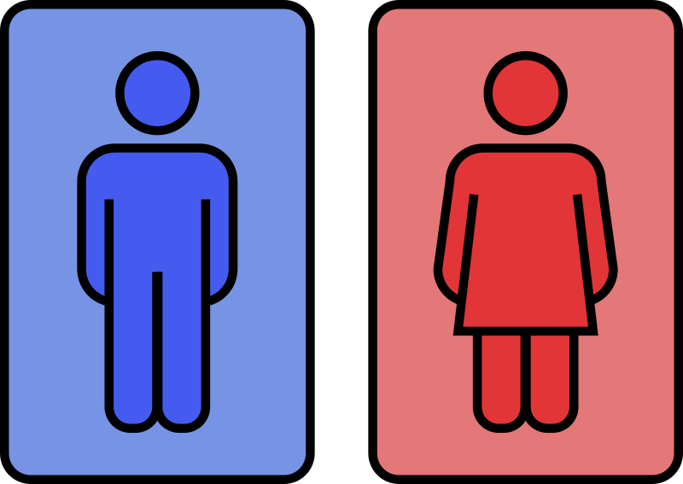
1. Introduction: Public Restrooms
The 2016 Healthy Hand Washing Survey, conducted by restroom fixture manufacturer Bradley Corporation
Normal people, on average people urinate in every 4 hours [1].
People have an aversion to touching certain restroom surfaces operate the toilet flusher with their foot [2].
%70 say they have had an unpleasant experience due to the conditions in a public restroom [2].
London scientists say one out of six cell phones tests positive for fecal matter [2].
Fig. 1 [13]

Slide 4
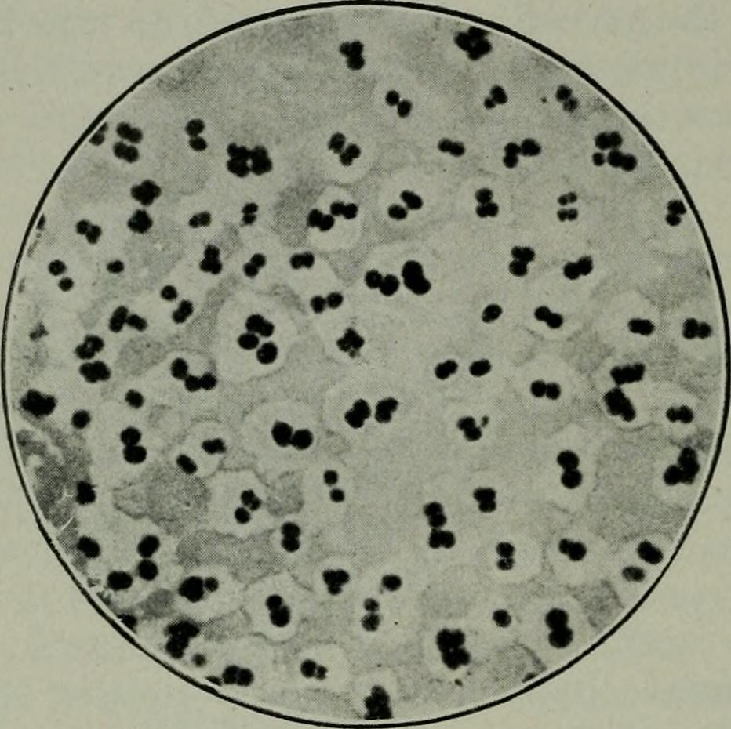
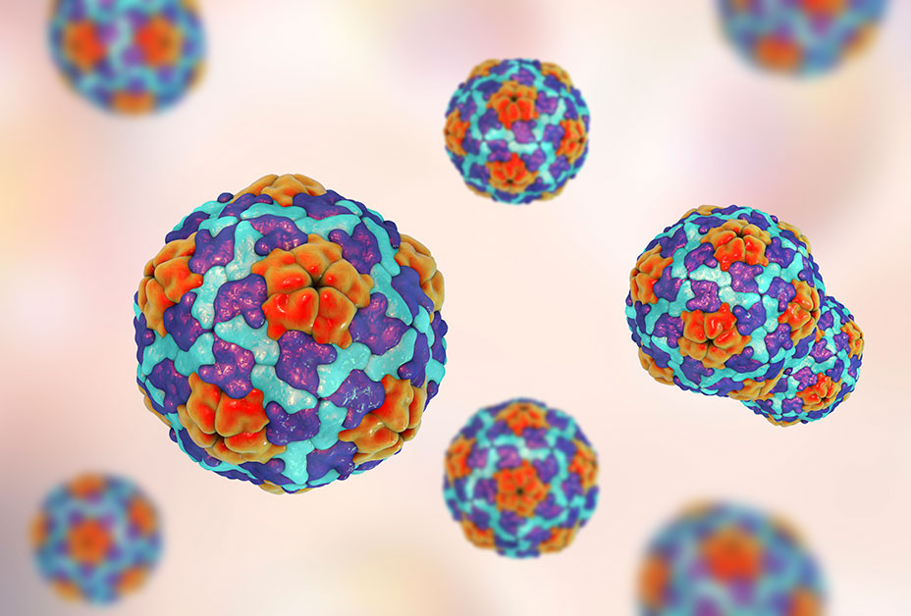

1. Introduction: Health Risks of Public Restrooms
Fig. 2: Pathogenic microbes [9]
Fig. 3: Hepatitis A [10]
Fig. 4: Salmonella [11]
Pathogenic microbes on toilets and other surfaces in public restrooms [3].
Hepatitis A in elementary school restrooms [3].
Salmonella in dorm toilets [3].

Slide 5

1. Introduction: Health Risks of Public Restrooms
Fig. 5: Norovirus [12]
Disease-causing viruses and bacteria, including norovirus in workspace, airplane and cruise ship bathrooms [3].

Slide 6
1. Introduction
ONE HUNDRED has initiated an online survey with 4546 participants in 8 countries in December 2020 [1].
%67
Agrees that the quality and hygiene of the toilets is a clear indicator for the general hygiene of a public space [1].
%32
A bad experience with quality and hygiene of toilet facilities in a public space is a reason to visit this place less often or to stay shorter [1].
Do not mind paying 1$, 1€ or 1£ for qualitative toilet facilities [1].
%44

Slide 7

1. Introduction
Frequency of Visiting the Park
Frequency of visiting the park | Park visitors (n = 152) % | Local People (n= 150) (%)
Everyday | 9 | 1
At least 1 day in a week | 18 | 2
At least 1 day in two week | 6 | 3
At least 1 day in a month | 20 | 4
At least 1 day in a year | 45 | 33
Not visiting | – | 53
Never | – | 4
Sum | 100 | 100
Fig. 7: Gençlik Parkı Ankara [20]
Gençlik Parkı is located in the center of Ankara, Ulus [6].
It has a wedding hall, amusement park, opera house, places for drinking tea and restaurants [6].
%15.7 of visitors stay in Gençlik Parkı for more than 4 hours [5].
It has two public restrooms on the outside [7].
Fig. 6: Frequency table of visiting the park [5]

Slide 8
1. Introduction
Purpose
Impact
Significance
To make the restroom clean most of the time
To be able to call cleaning staff when needed
Prevent possible diseases

Slide 9
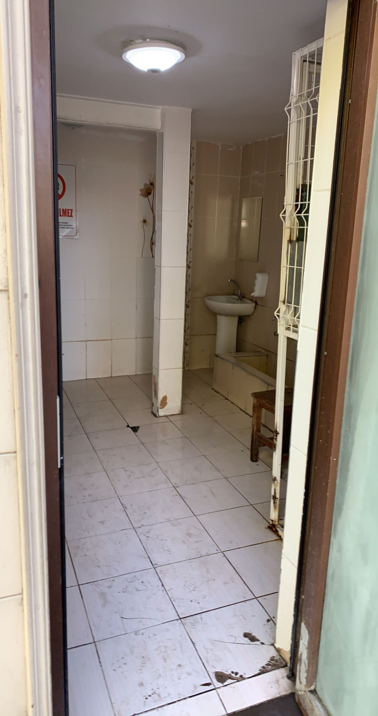
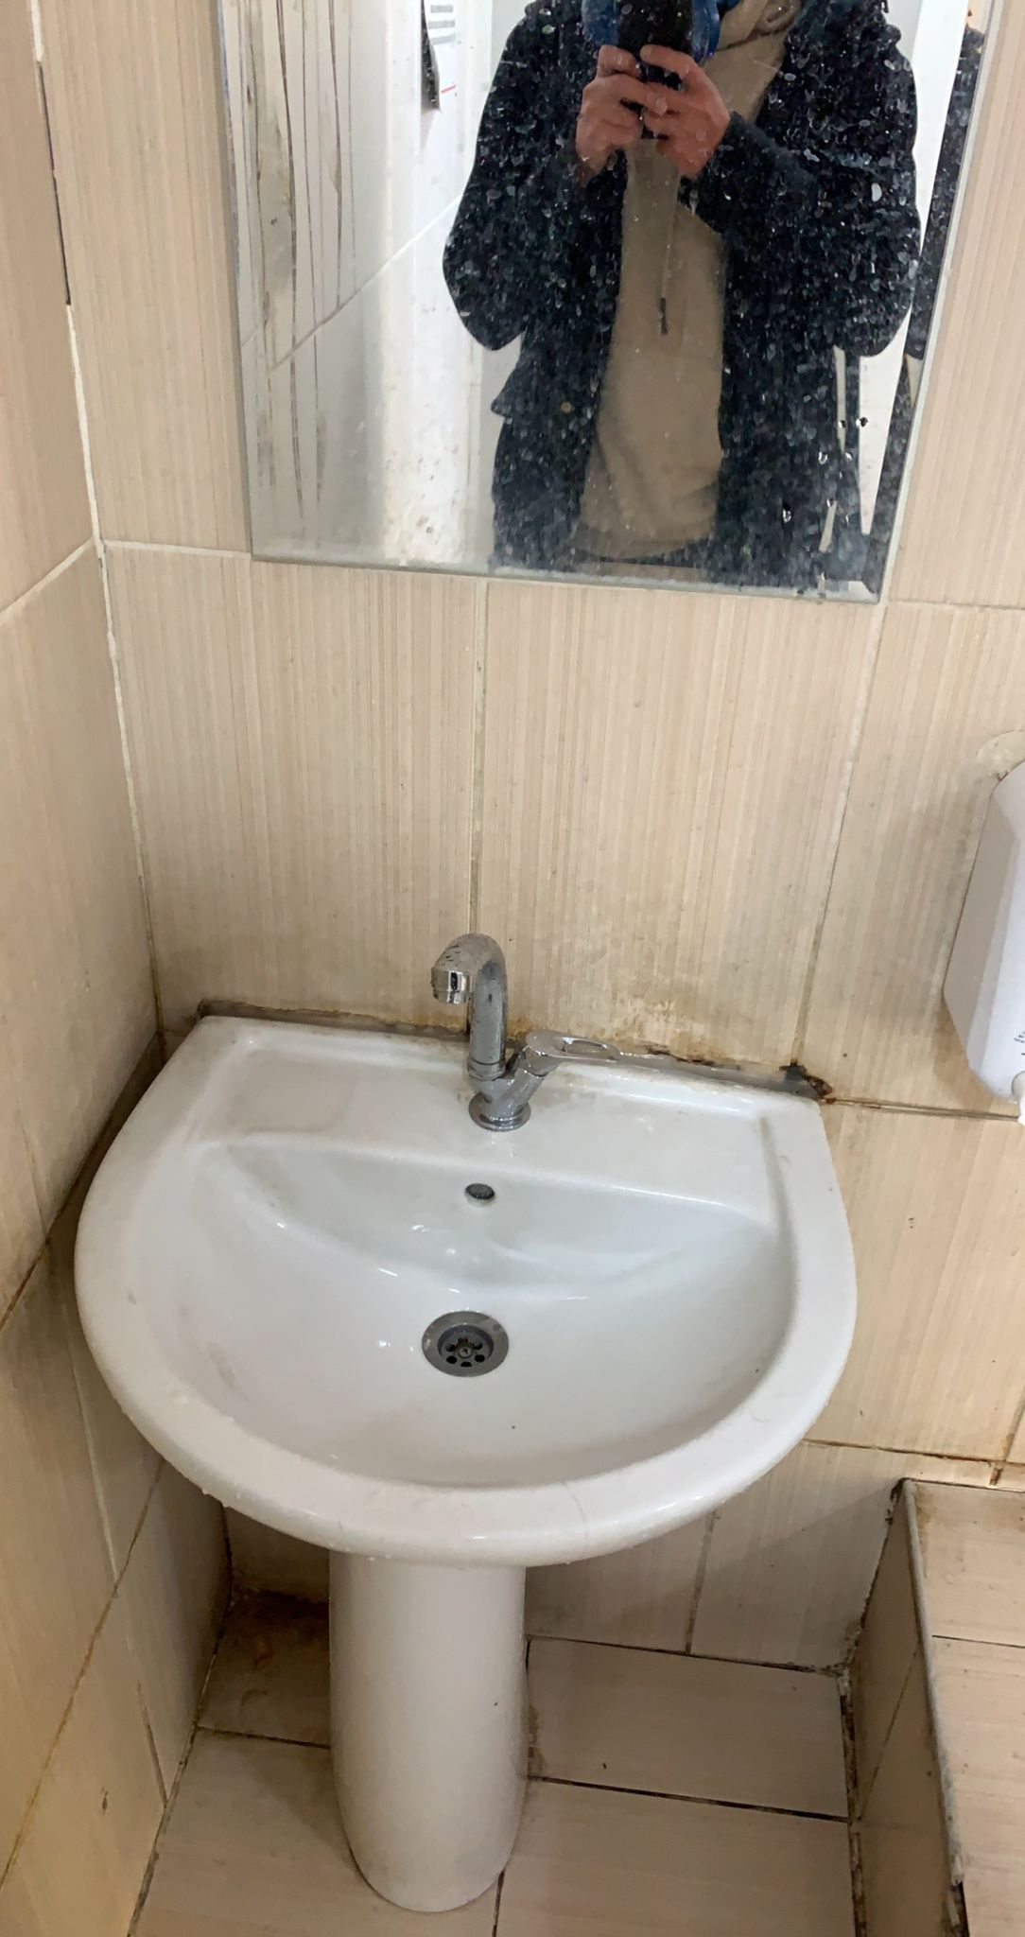
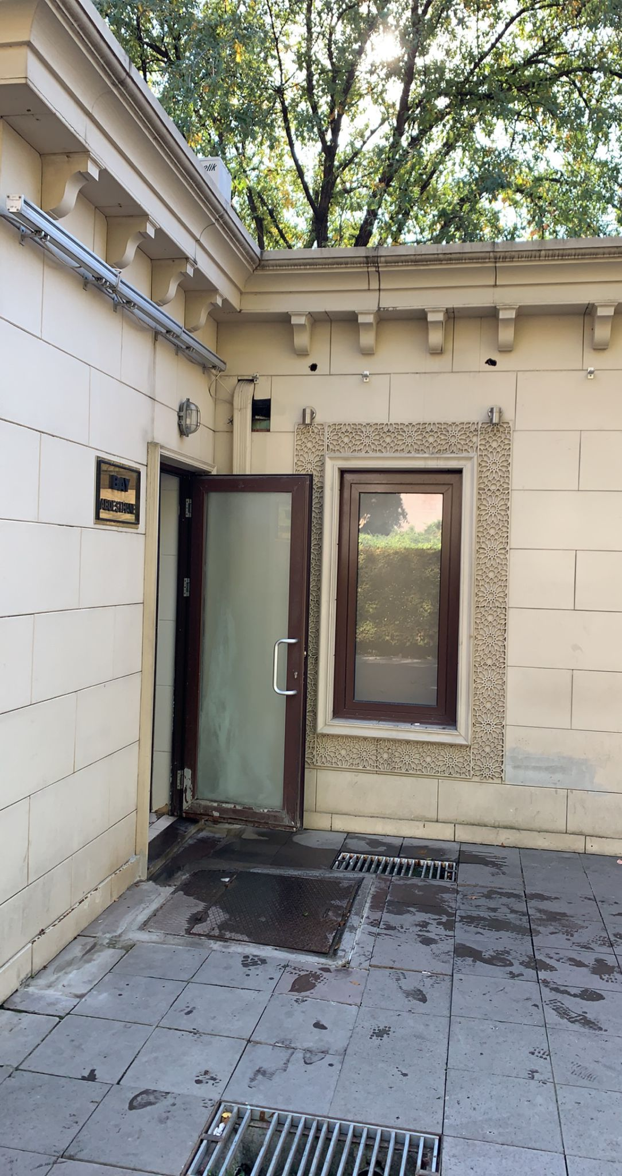
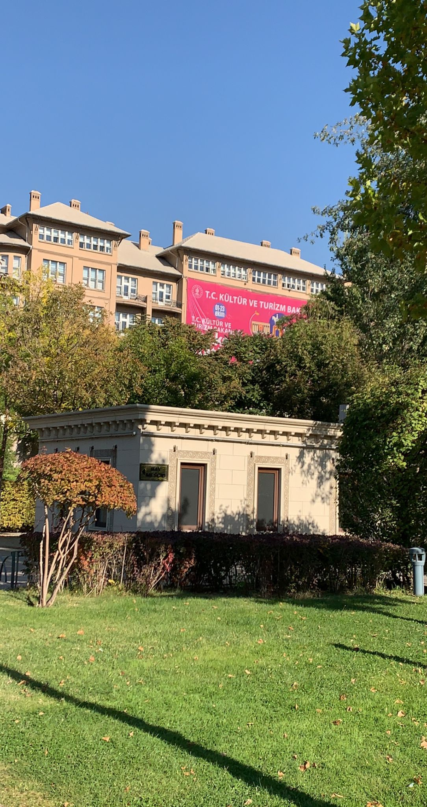
2. Problem Definition
Problem: Masjid toilet is not clean in Ankara Gençlik Parkı
Fig. 7: Entrance of the restroom [21]
Fig. 8: Sink of the restroom [21]
Fig. 9: Entrance [21]
Fig. 10: Masjid [21]

Slide 10
2. Problem Definition
Who: The people who visits Ankara Gençlik Parkı
What: Cleaning is done in a certain frequency not after a problem occurs
When: Always, but most at weekends and on special days like end of the school day [7]
Where: Ankara Gençlik Parkı
Why: Lack of ability to call staff when needed
How: This is an important problem because it increase risk of diseases

Slide 11
2. Problem Definition
Root Cause: Cleaning staff is not cleaning the restroom when it is needed.
Floors are wet and dirty
Sink is not clean
Two toilet cubicle are not clean
The restroom is cleaned everyday for only 5 times by municipality [7].

Slide 12
3. Proposed Solutions
1- A QR code for letting the staff know which part of the restroom has a problem
2- No Touch Button for calling the staff to indicate that there is a problem
3- An automated system for calling the staff that consists of a dirt detection system, water leak detector and waste bin fill-level sensors

Slide 13
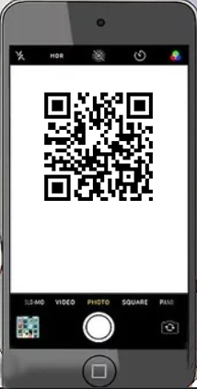
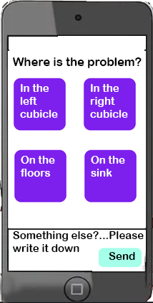

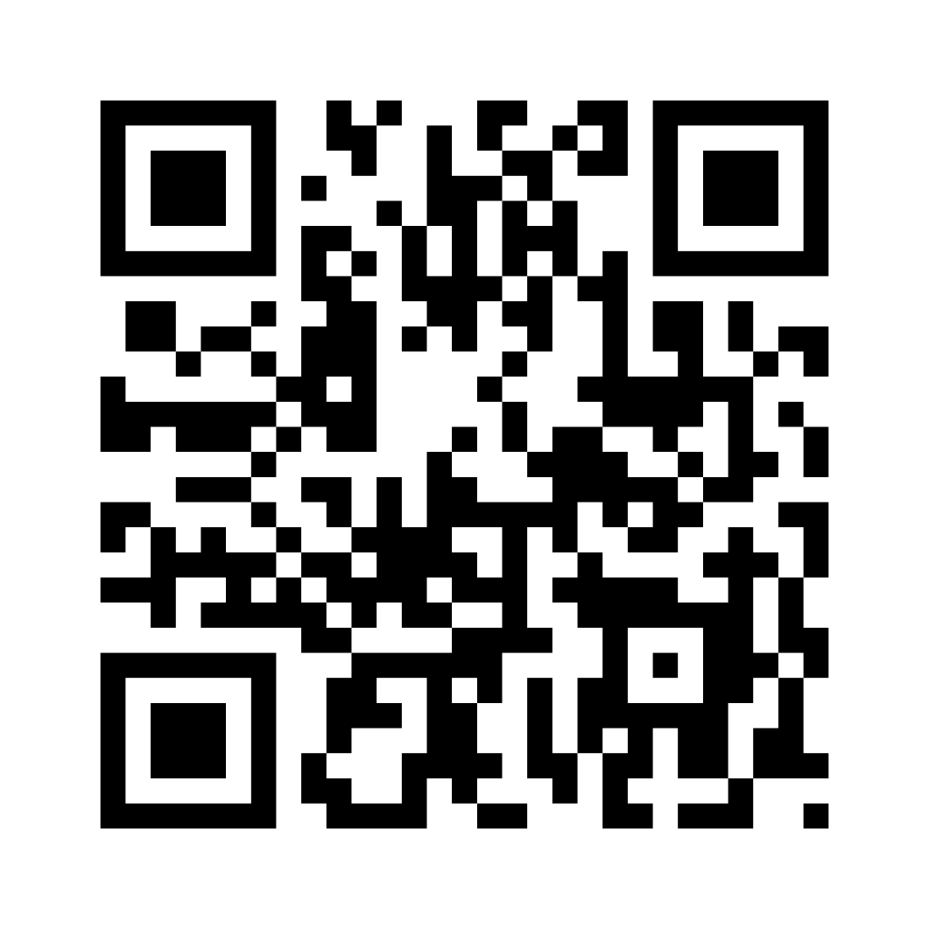
Solution 1: QR Code System
Fig. 11: QR Code System [8]

Slide 14
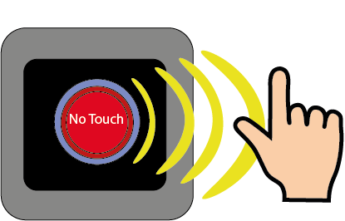
Solution 2: No Touch Button Notification System
Fig. 12: No Touch Button Notification System [9]

Slide 15
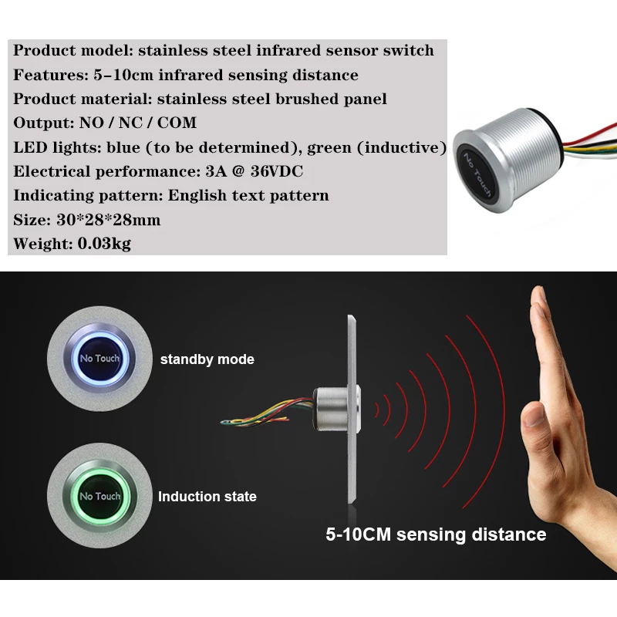
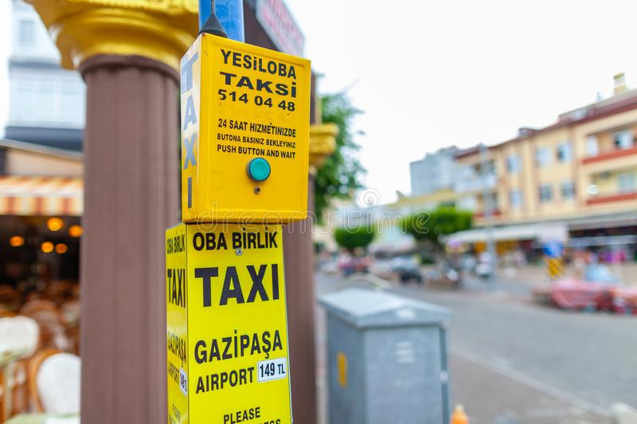
How it works?
Fig. 13: Taxi Buttons [19]
Fig. 14: No Touch Button [20]
1000 m - 3000 m distance range
Ability to send stop information

Slide 16
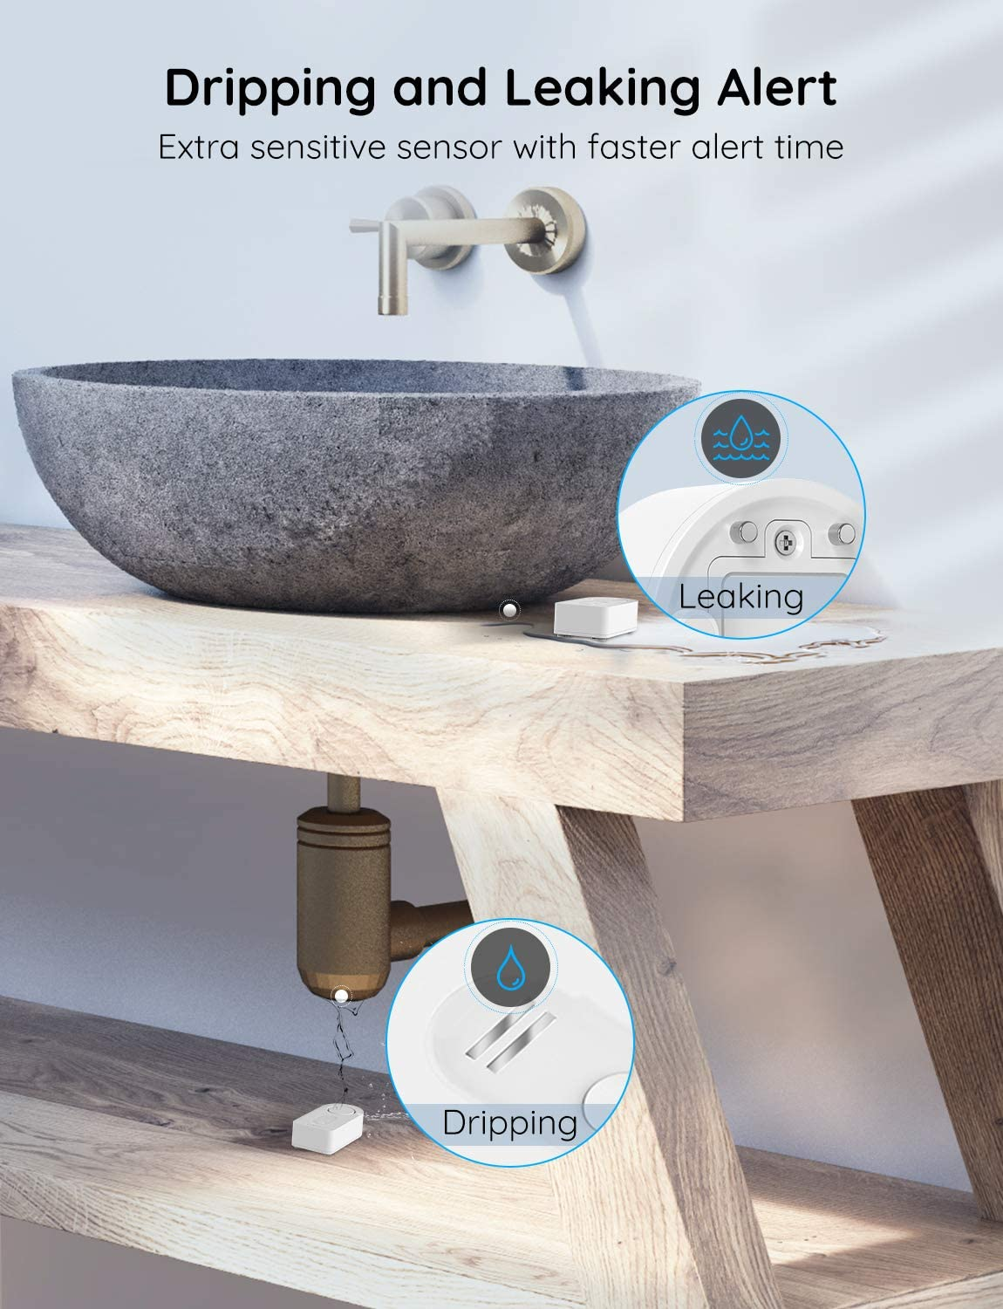
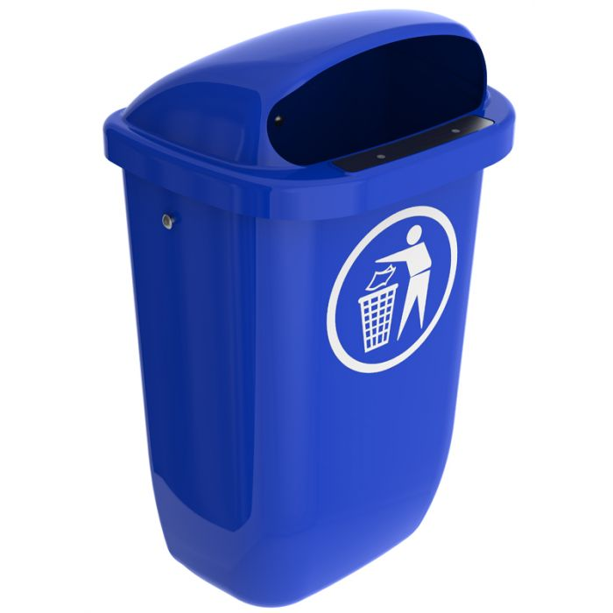
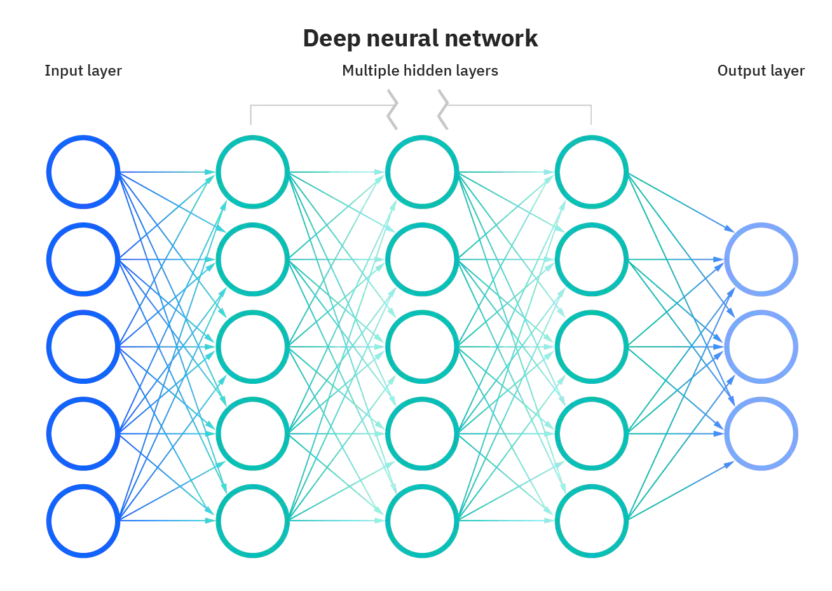
Solution 3: Automated System
Fig. 15 [15]
Fig. 16 [14]
Fig. 17 [16]
IoT enabled Bin [18].
Water Leak Detector [14].
Dirt detection algorithm [17].

Slide 17
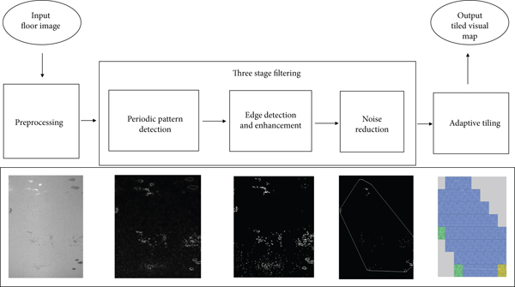
Solution 3: Automated System
Fig. 18: Dirt Detection Algorithm [16]

Slide 18
4. Criteria for Assessing Proposed Solutions
1-COST
1.1 QR Code System
The cost of the design website
The cost of the domain and host of the website
The cost of the phones that will be given to the cleaning staff
1.2 No Touch Button System
The cost of the taxi button
The cost of the no-touch button
1.3 Automated System
The cost of the IoT-enabled bin
The cost of the water leak detector
The cost of the systems that detects dirt

Slide 19
4. Criteria for Assessing Proposed Solutions
2- Applicability
3- Efficiency

Slide 20
5. Proposed Research Methodology
Expert Opinion
Market Research
Literature Review
How the dirt detection algorithm implemented was asked to an engineer
How the collected signals of the detectors will notify the staff was consulted to an engineer
How efficient and applicable the solutions were asked to an engineer
Required hardwares, softwares or cloud services was determined on internet
How efficient and applicable the solutions were researched

Slide 21
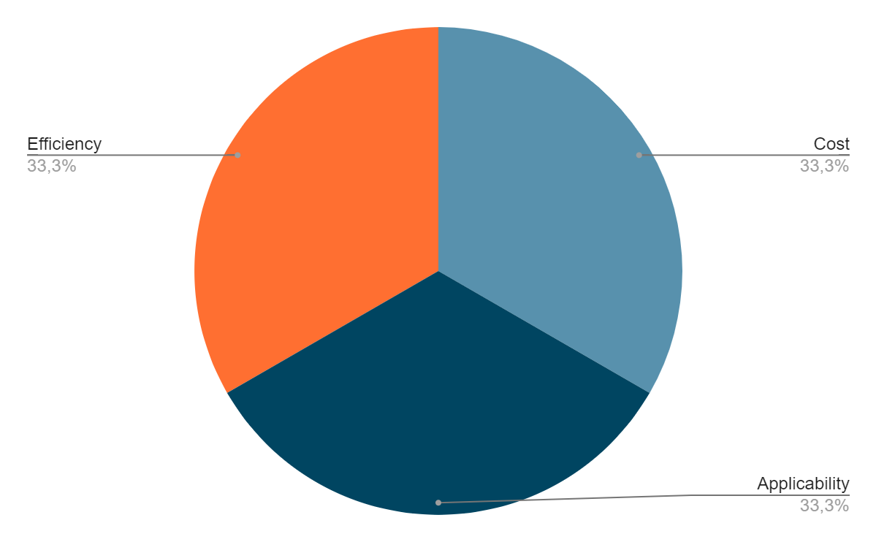
6.Results and Analysis
Fig. 19: Assigned Weight of Criterias

Slide 22
6.1. Cost Analysis
1. QR Code System (Yearly Cost)
Design Website | Domain | Host | Phone | Installation | Maintenance | Total
100$ [22] | 7.99$/y [23] | 14.99$/m [23] | 500$ [24] | 50$ [25] | 50$ [25] | 887,87$
Table 1: QR Code System Yearly Cost Table
2. No-touch Button System (Yearly Cost)
Taxi Button | No-touch button | Installation | Maintenance | Total
55$ [26] | 9.99$ [27] | 50$ [25] | 50$ [25] | 164,99$
Table 2: No-Touch Button System Yearly Cost Table
3. Automated System (Yearly Cost)
IoT enabled bin | Water leak detector | Dirt detection system | Installation | Maintenance | Total
799$ [25] | 9.99$[28] | 1299$ [25] | 250$ [25] | 500$ [25] | 2.855,99$
Table 3: Automated System Yearly Cost Table

Slide 23
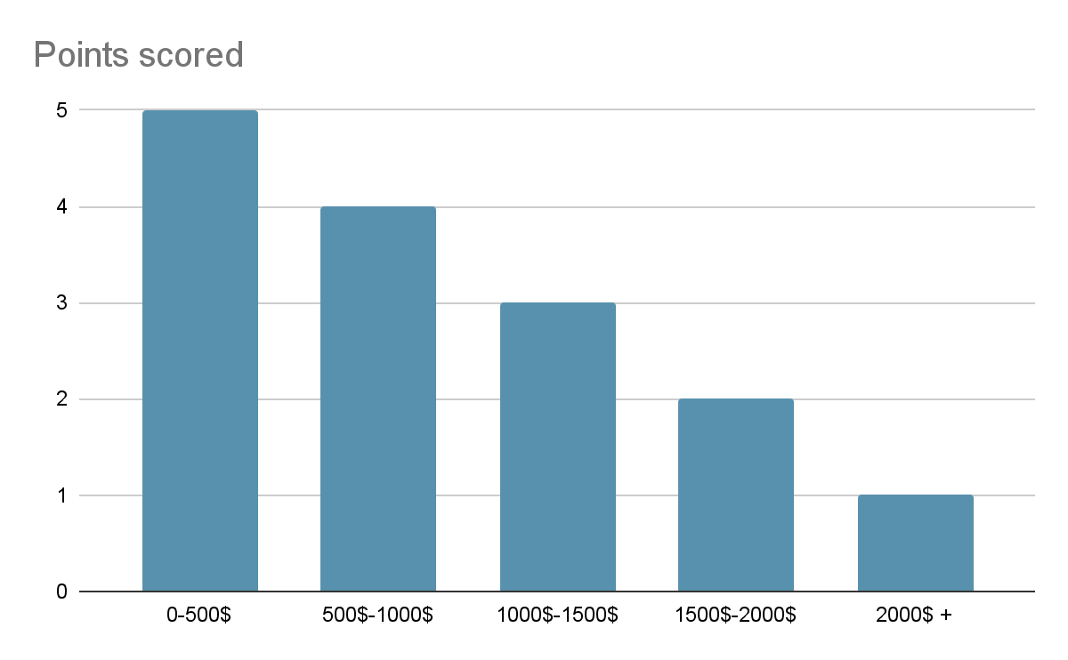
6.1. Cost Analysis
Municipality is asked to create the cost evaluation table.
Table 4: Cost Evaluation Table
1. QR Code System
2. No-touch Button System
3. Automated System
Total Cost: 887,87$
Points: 4/5
Total Cost: 164,99$
Points: 5/5
Total Cost: 2.855,99$
Points: 1/5

Slide 24
6.2.1 Applicability Analysis of QR Code System
Questions | Excellent (5) | Satisfactory (4) | Needs improvement (3) | Poor (2) | Unsatisfactory (1)
How easy is it to implement the solution? |  | x
What is the lifetime of the devices? | x
How hygienic is the solution? |  |  | x
How easy it is to use? | x
Table 4: Applicability Analysis of QR Code System Table
Total: 17

Slide 25
6.2.2 Applicability Analysis of No-Touch Button System
Questions | Excellent (5) | Satisfactory (4) | Needs improvement (3) | Poor (2) | Unsatisfactory (1)
How easy is it to implement the solution? |  | x
What is the lifetime of the devices? |  |  | x
How hygienic is the solution? | x
How easy it is to use? | x
Table 5: Applicability Analysis of No-Touch Button System Table
Total: 17

Slide 26
6.2.3 Applicability Analysis of Automated System
Questions | Excellent (5) | Satisfactory (4) | Needs improvement (3) | Poor (2) | Unsatisfactory (1)
How easy is it to implement the solution? |  |  |  |  | x
What is the lifetime of the devices? |  |  |  | x
How hygienic is the solution? | x
How easy it is to use? | x
Table 6: Applicability Analysis of Automated System Table
Total: 13

Slide 27
6.2.1 Efficiency Analysis of QR Code System
Questions | Excellent (5) | Satisfactory (4) | Needs improvement (3) | Poor (2) | Unsatisfactory (1)
Will it help keeping the restroom clean? | x
Will it provide help from cleaning staff when it is needed? | x
Will it prevent diseases? |  | x
How long does it take for the solution to make the restroom clean? |  | x
Table 7: Efficiency Analysis of QR Code System Table
Total: 18

Slide 28
6.2.2 Efficiency Analysis of No-Touch Button System
Questions | Excellent (5) | Satisfactory (4) | Needs improvement (3) | Poor (2) | Unsatisfactory (1)
Will it help keeping the restroom clean? | x
Will it provide help from cleaning staff when it is needed? | x
Will it prevent diseases? |  |  | x
How long does it take for the solution to make the restroom clean? |  |  | x
Total: 16
Table 8: Efficiency Analysis of No-Touch Button System Table

Slide 29
6.2.3 Efficiency Analysis of Automated System
Questions | Excellent (5) | Satisfactory (4) | Needs improvement (3) | Poor (2) | Unsatisfactory (1)
Will it help keeping the restroom clean? |  | x
Will it provide help from cleaning staff when it is needed? |  | x
Will it prevent diseases? |  | x
How long does it take for the solution to make the restroom clean? | x
Total: 17
Table 9: Efficiency Analysis of Automated System Table

Slide 30
7. Conclusion and Recommendations
1. QR Code System
2. No-touch Button System
Cost | 16/20
Applicability | 17/20
Efficiency | 18/20
Cost | 20/20
Applicability | 17/20
Efficiency | 16/20
Total: 51
Total: 53
Table 10: QR Code System Evaluation Table
Table 11: No-touch Button System Evaluation Table
3. Automated System
Cost | 4/20
Applicability | 13/20
Efficiency | 17/20
Total: 34
Table 12: Automated System Evaluation Table

Slide 31
7. Conclusion and Recommendations
The best solution is No-touch Button System when the criterias cost, applicability and efficiency are considered
Advantages:
Does not require complicated and costly hardware
No need to touch any surface
Maintains privacy
Disadvantages:
Could not able to indicate where the cleaning problem occurs.(On the floor or which cubicle?)
Since it is not automated, people may not prefer to call the staff

Slide 32
7. Conclusion and Recommendations
Action Plan
 | W1 | W2 | W3 | W4 | W5
1. Taxi Button will be ordered.
2. No-touch button will be ordered.
3. Taxi button and no-touch button will be merged.
4. Municipality will hire a technician to implement the system.
5. Municipality needs to train the staff
Table 13: Gantt Chart of the Action Plan

Slide 33
8. References
[1] “Urinary frequency,” Bladder & Bowel Community, 16-Aug-2021. [Online]. Available: https://www.bladderandbowel.org/bladder/bladder-conditions-and-symptoms/frequency/#:~:text=For%20most%20people%2C%20the%20normal,times%20they%20visit%20the%20toilet. [Accessed: 26-Oct-2022].
[2] “Survey reveals top ten restroom complaints/usage stats,” CleanLink. [Online]. Available: https://www.cleanlink.com/news/article/Survey-Reveals-Top-Ten-Restroom-ComplaintsUsage-Stats--19737. [Accessed: 26-Oct-2022].
[3]“Research,” ONE HUNDRED RESTROOMS, 13-Jan-2022. [Online]. Available: https://onehundredrestrooms.com/leading-in-public-restrooms/research/. [Accessed: 26-Oct-2022].
[4] A. Callahan, “How bad are the germs in public restrooms, really?,” The New York Times, 21-Jun-2022. [Online]. Available: https://www.nytimes.com/2022/06/21/well/live/public-bathrooms-health-safety.html. [Accessed: 26-Oct-2022].
[5] DEMİR E "Park Kullanım Kalıpları: Gençlik Parkı Ziyaretçileri Üzerine Bir Araştırma." Çağdaş Yerel Yönetimler, 14, ss.19 - 42, 2005.
[6] E. Özden, “Ankara Gençlik Parkı - Nerede - Nasıl Gidilir ?,” gezicenga.com, 22-Nov-2019. [Online]. Available: https://gezicenga.com/ankara-genclik-parki/. [Accessed: 26-Oct-2022].
[7] Anonymous, Staff. 2022.

Slide 34
8. References
[8] K. Şenyiğit, QR code system. 2022.
[9] K. Şenyiğit, No Touch Button Notification System. 2022.
[10] “Hepatitis A,” Centers for Disease Control and Prevention, 22-Jul-2022. [Online]. Available: https://www.cdc.gov/dotw/hepatitisa/index.html. [Accessed: 26-Oct-2022].
[11] P. D. İF. T. A. H. A. R. KÖKSAL, Salmonella Nedir, Belirtileri ve Tedavisi - Acıbadem Hayat, 23-Sep-2022. [Online]. Available: https://www.acibadem.com.tr/hayat/salmonella-nedir/. [Accessed: 26-Oct-2022].
[12] C. Arbanas, “How highly contagious norovirus infection gets its start,” Washington University School of Medicine in St. Louis, 19-Apr-2018. [Online]. Available: https://medicine.wustl.edu/news/how-fast-spreading-norovirus-infection-gets-its-start/. [Accessed: 26-Oct-2022].
[13] E. Akama, “Japanese toilet - toilet logo,” Japan Explorer, 18-Dec-2015. [Online]. Available: https://www.japanexplorer.com.au/japanese-toilet/toilet-logo/. [Accessed: 26-Oct-2022].
[14] “Amazon.” [Online]. Available: https://www.amazon.com/Detector-Wireless-Notification-Security-Basement/dp/B07J9HZ5VN. [Accessed: 25-Oct-2022].

Slide 35
8. References
[15] Axess Industries, “Poubelle d'extérieur en plastique: Corbeilles de propreté,” Axess Industries. [Online]. Available: https://www.axess-industries.com/mobilier-urbain/amenagement-urbain/corbeilles-de-proprete/poubelle-d-exterieur-en-plastique-p-182139. [Accessed: 26-Oct-2022].
[16] Filtreleme ölçütü: IBM Cloud Education, “Yapay Zeka (AI) nedir?,” IBM. [Online]. Available: https://www.ibm.com/tr-tr/cloud/learn/what-is-artificial-intelligence. [Accessed: 26-Oct-2022].
[17] B. Ramalingam, P. Veerajagadheswar, M. Ilyas, M. R. Elara, and A. Manimuthu, “Vision-based dirt detection and adaptive tiling scheme for selective area coverage,” Journal of Sensors, 30-Dec-2018. [Online]. Available: https://www.hindawi.com/journals/js/2018/3035128/. [Accessed: 26-Oct-2022].
[18] “Smart Bin Sensor: Iot bin sensor singapore,” Smart Bin Sensor | IoT Bin Sensor Singapore, 21-Mar-2022. [Online]. Available: https://v3smarttech.com/fill-level-sensors/. [Accessed: 26-Oct-2022].
[19] J. Hüttenhölscher, “Turkish taxi calling sign stands on a street editorial image - image of stands, motor: 128036625,” Dreamstime. [Online]. Available: https://www.dreamstime.com/antalya-turkey-september-turkish-taxi-calling-sign-stands-street-antalya-turkish-taxi-calling-sign-stands-street-image128036625. [Accessed: 26-Oct-2022].

Slide 36
8. References
[20] “Gençlik Parkı Gerçekte Kime devredildi? Taraflar Yanıt Verdi,” Independent Türkçe, 18-Jun-2019. [Online]. Available: https://www.indyturk.com/node/42931/ekonomi%CC%87/gen%C3%A7lik-park%C4%B1-ger%C3%A7ekte-kime-devredildi-taraflar-yan%C4%B1t-verdi. [Accessed: 26-Oct-2022].
[21] K. Şenyiğit, Gençlik Parkı Masjid Restroom. 2022.
[22] V. Gaeta, “How much does a website design or redesign cost in 2023?,” IMPACT Inbound Marketing Agency, 05-Dec-2022. [Online]. Available: https://www.impactplus.com/blog/how-much-does-a-website-redesign-cost#:~:text=Designing%20a%20website%20yourself%20is,%24 40%2C000%20to%20%2475%2C000%20or%20more. [Accessed: 24-Dec-2022].
[23] “Make your own way,” GoDaddy. [Online]. Available: https://www.godaddy.com/. [Accessed: 24-Dec-2022].
[24] M. S. Erdoğan, private communication, December 2022
[25] E. Tüzün, private communication, December 2022
[26] “Taksi çağırma Sistemi Butonu,” Taksi Çağırma Sistemleri. [Online]. Available: https://www.dolunayled.com/urun/taksi-cagirma-sistemi-butonu. [Accessed: 24-Dec-2022].
[27] “AliExpress - online shopping for popular electronics, fashion, home ...” [Online]. Available: https://sale.aliexpress.com/. [Accessed: 24-Dec-2022].

